Slide 1



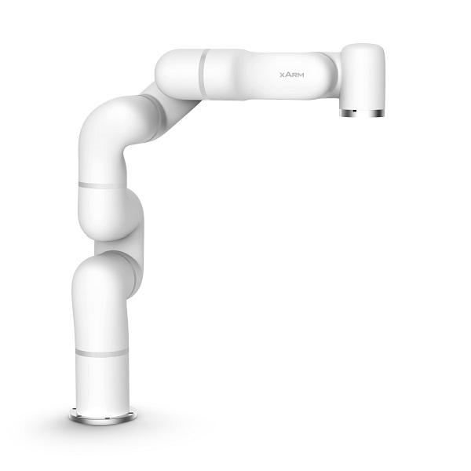
Introduction to ROS
How to use robot manipulators in ROS

Slide 2
In previous days …
Day 1: ROS basics
What’s ROS?
What elements can be found in ROS ?
How is communication stablished
User interactions with ROS
Data visualisation
Notes:
<number>

Slide 3
Schedule for the day
Morning Content
Robot modelling tools available in ROS
Gazebo, a dynamics simulator that can be controlled using ROS
Lunch pause
Afternoon Content
Usage of robot manipulators in ROS
MoveIt!, a planning library for robotic arms
tf2, coordinate frames implemented in ROS
Notes:
<number>

Slide 4

See you in an hour

Slide 5
Welcome back!

Slide 6
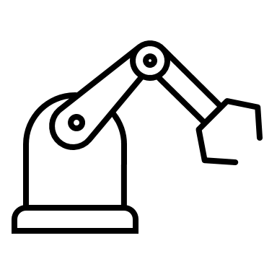

Robot modelling Overview
<?xml version="1.0"?>
<robot name="myrobot">
…..
</robot>
REAL ROBOT
SIMULATED ROBOT
URDF file
Notes:
What’s is Robot modelling?
Its an abstraction or, a description, of the kinematics of a robot.
In ROS, this is done by using URDF. Unified Robotic Description Format URDF is an XML format for ROS models, but it can also be linked to Gazebo.
URDF models describes properties of the model.
A model is comprised by objects represented by simple geometric shapes to create an abstraction of the real robot.
<number>

Slide 7
Robot modelling Structure of the file
<?xml version="1.0"?>
<robot name="myrobot">
…..
</robot>
Header that identifies the code as XML
Robot tags. This will encapsule all the elements of the robot description
NOTICE HOW ALL TAG HAVE AN INITIAL TAG
AND A CLOSING TAG
URDF file
(or Xacro file)
Notes:
What’s is Robot modelling?
Its an abstraction or, a description, of the kinematics of a robot.
In ROS, this is done by using URDF. Unified Robotic Description Format URDF is an XML format for ROS models, but it can also be linked to Gazebo.
URDF models describes properties of the model.
A model is comprised by objects represented by simple geometric shapes to create an abstraction of the real robot.
<number>

Slide 8
Robot modelling URDF (Unified Robotic Description Format)
Joints
Links
SIMULATED ROBOT
Notes:
Basic elements are links and joints
<number>

Slide 9
Robot modelling URDF Model - Links
VISUAL
Origin
Geometry
Material
COLLISION
Link
Origin
Geometry
LINK TAG
<link name="base_link">
…..
</link>
INERTIAL
Mass
Rotational inertia matrix
NOTE: For simularion the main link is usually called base_link
Notes:
Each link is described using the following cathegories :
- Visuals – what the user sees
-material
-colours
- textures
- meshes:
- Collisions – this describes the physical space the object requires. This is usually based on simple geometric shapes.
Links specifies union of object. Joint.
This can be done by Rviz by ROS, or Gazebo, which as a more complex simulation, in which we`ll go later in further detail.
<number>

Slide 10
Robot modelling URDF Model – Visual – origin tag
<link name=“base_link”>
<visual>
<origin xyz="0 0 0" rpy="0 0 0" />
<geometry>
<box size="1 1 1" />
</geometry>
<material name="Cyan">
<color rgba="0 1.0 1.0 1.0"/>
</material>
</visual>
</link>
Origin of the link
VISUAL
Origin
Geometry
Material
Notes:
Visuals:
The origin of the element is going to depend on the previous link it is attached to. For the moment lets leave it to origin.
<number>

Slide 11
Robot modelling URDF Model – Visual – geometry tag
<link name=“base_link”>
<visual>
<origin xyz="0 0 0" rpy="0 0 0" />
<geometry>
<box size="1 1 1" />
</geometry>
<material name="Cyan">
<color rgba="0 1.0 1.0 1.0"/>
</material>
</visual>
</link>
VISUAL
Basic shapes such as:
Cylinder (radius, length)
Spheres (radius)
Boxex (length, width, depth)
Origin
Geometry
Material
Notes:
Basic shapes are the simplest and most common way to start modelling a robot.
<number>

Slide 12
Robot modelling URDF Model – Visual – geometry tag
<link name=“base_link”>
<visual>
<origin xyz="0 0 0" rpy="0 0 0" />
<geometry>
<mesh filename="package://urdf/meshes/model.dae"/>
</geometry>
<material name="Cyan">
<color rgba="0 1.0 1.0 1.0"/>
</material>
</visual>
</link>
VISUAL
A 3D model of the piece can be loaded.
The files accepted are:
Collada (.dae)
Inventor or other
software in STL (.stl)
Origin
Geometry
Material
Notes:
3D representation made with Collada or 3d software dae or stl .
<number>

Slide 13
Robot modelling URDF Model – Visual – material tag
<link name=“base_link”>
<visual>
<origin xyz="0 0 0" rpy="0 0 0" />
<geometry>
<mesh filename="package://urdf/meshes/model.dae"/>
</geometry>
<material name="Cyan">
<color rgba="0 1.0 1.0 1.0"/>
</material>
</visual>
</link>
VISUAL
Origin
Geometry
Material
Materials can be:
Colors, or textures.
Notes:
3D representation made with Collada or 3d software dae or .
<number>

Slide 14
Robot modelling URDF Model – Collision
EXAMPLE CODE
<collision>
<origin xyz="0 0 0" rpy="0 0 0"/>
<geometry>
<cylinder radius="1" length="0.5"/>
</geometry>
</collision>
COLLISION
Origin
Geometry
This can be exactly the same as
The visual, but even when a 3D
Model is loaded to the visual,
the collision can remain a simple
geometric shape
Notes:
This usually stays as geometric shapes, but can be exactly the same as the visual description.
<number>

Slide 15
Robot modelling URDF Model – Inertial
NOTE
<inertial>
<mass value="10"/>
<inertia ixx="0.4" ixy="0.0" ixz="0.0" iyy="0.4" iyz="0.0" izz="0.2"/>
</inertial>
Inertias can be “ignored” for Rviz simulations, but they are a must for Gazebo Simulations
INERTIAL
Mass
Rotational inertia matrix
Look for list of moments of inertia for reference
(some links will be added to the cheat sheet)
Notes:
For just a basic visualisation, with no simulation of dynamics. Inertia could be negligible, but for gazebo it must to be added
<number>

Slide 16
Robot modelling Xacro - function-based simplification
IMPORTANT
To change URDF to Xacro, the following lines has to be added in the first line of your model.
<?xml version="1.0"?>
<robot xmlns:xacro="http://www.ros.org/wiki/xacro" name=“model">
Also the file will change extension to .xacro.
Use to simplify the code of your model. It can be use for:
Constant
Math
Macros
Notes:
Xacro comes from the XML Macro, and it is useful to simplify
<number>

Slide 17
Robot modelling Xacro - function-based simplification
EXAMPLE CODE
<xacro:property name="width" value="0.2" />
<xacro:property name="bodylen" value="0.6" />
<link name="base_link">
<visual>
<geometry>
<cylinder radius="${width}" length="${bodylen}"/>
</geometry>
<material name="blue"/>
</visual>
<collision>
<geometry>
<cylinder radius="${width}" length="${bodylen}"/>
</geometry>
</collision>
</link>
Use to simplify the code of your model.
It can be use for:
Constant
Math
Macros
Use to simplify the code of your model.
It can be use for:
Constant
Math
Macros
Notes:
Xacro comes from the XML Macro, and it is useful to simplify
<number>

Slide 18
Robot modelling Xacro - function-based simplification
EXAMPLE CODE
<xacro:property name=“wheeldiam" value="0.2" />
<xacro:property name=“width" value="0.1" />
<xacro:property name=“reflect" value=“-1" />
<cylinder radius="${wheeldiam/2}" length="0.1"/>
<origin xyz="${reflect*(width+.02)} 0 0.25" />
Use to simplify the code of your model.
It can be use for:
Constant
Math
Macros
Notes:
Xacro comes from the XML Macro, and it is useful to simplify
<number>

Slide 19
Robot modelling Xacro - function-based simplification
EXAMPLE CODE
<xacro:macro name="default_inertial"
params="mass">
<inertial>
<mass value="${mass}" />
<inertia ixx="1.0" ixy="0.0" ixz="0.0"
iyy="1.0" iyz="0.0"
izz="1.0" />
</inertial>
</xacro:macro>
The macro is called using the next line:
<xacro:default_inertial mass=”5” />
Use to simplify the code of your model.
It can be use for:
Constant
Math
- Macros
Notes:
Xacro comes from the XML Macro, and it is useful to simplify
<number>

Slide 20

We’ll be back in 15 min

Slide 21
Robot modelling Joints and links
Child frame
Joint
Parent Link
x
z
Parent Link
y
Joint axis
Child Link​
Child Link​
Child Link​
z
x
y
Parent frame
Notes:
The joint element describes the kinematics and dynamics of the joint and also specifies the safety limits of the joint.
Add how parent link interacts with the world (known as base link) .
The importance of names, depending in which software you are using.
<number>

Slide 22
Robot modelling Joints
Example Code
Different kinds of joints:
Fixed - no motion between the two links
Continuous - It can take many angles, with no restriction.
Revolute-This joint moves along an axis, and it has a limit
Prismatic- this joint moves only along one single axis, and it has a limit
<joint name="joint1" type="fixed">
<parent link="base_link"/>
<child link="link1"/>
<origin xyz="0 0 0.3"/>
</joint>

Slide 23
Robot modelling Joints
Example Code
Different kinds of joints:
Fixed- no motion between the two links
Continuous - It can take many angles, with no restriction
Revolute-This joint moves along an axis, and it has a limit
Prismatic- this joint moves only along one single axis, and it has a limit
<joint name="head_swivel" type="continuous">
<parent link="base_link"/>
<child link="head"/>
<axis xyz="0 0 1"/>
<origin xyz="0 0 0.3"/>
</joint>

Slide 24
Robot modelling Joints
Example Code
Different kinds of joints:
Fixed- no motion between the two links
Continuous - It can take many angles, with no restriction
Revolute -This joint moves along an axis, and it has a limit
Prismatic- this joint moves only along one single axis, and it has a limit
<joint name="left_gripper_joint" type="revolute">
<axis xyz="0 0 1"/>
<limit effort="1000.0" lower="0.0" upper="0.548"
velocity="0.5"/>
<origin rpy="0 0 0" xyz="0.2 0.01 0"/>
<parent link="gripper_pole"/>
<child link="left_gripper"/>
</joint>

Slide 25
Robot modelling Joints
Example Code
Different kinds of joints:
Fixed- no motion between the two links
Continuous - It can take many angles, with no restriction.
Revolute-This joint moves along an axis, and it has a limit.
Prismatic - this joint moves only along one single axis, and it has a limit.
<joint name="gripper_extension" type="prismatic">
<parent link="base_link"/>
<child link="gripper_pole"/>
<limit effort="1000.0" lower="-0.38" upper="0" velocity="0.5"/>
<origin rpy="0 0 0" xyz="0.19 0 0.2"/>
</joint>
Notes:
Add extras planar
<number>

Slide 26
Robot modelling Joint, links and TFs
Child frame
Joint
Parent Link
x
z
Parent Link
y
Joint axis
Child Link​
Child Link​
Child Link​
z
x
y
Parent frame
Notes:
The joint element describes the kinematics and dynamics of the joint and also specifies the safety limits of the joint.
Add how parent link interacts with the world (known as base link) .
The importance of names, depending in which software you are using.
<number>

Slide 27
Parse a URDF model in RVIZ
To open in terminal, add in launch file
<?xml version="1.0" ?>
<launch>
<param name="robot_description" command="$(find xacro)/xacro --inorder '$(find puzzlebot_gazebo)/urdf/puzzlebot.xacro'"/>
<node name="robot_state_publisher" pkg="robot_state_publisher" type="state_publisher"/>
<!-- Launch rviz -->
<node type="rviz" name="rviz" pkg="rviz" />
<node name="joint_state_publisher" pkg="joint_state_publisher" type="joint_state_publisher" >
<param name="use_gui" value="True"/>
</node>
</launch>

Slide 28
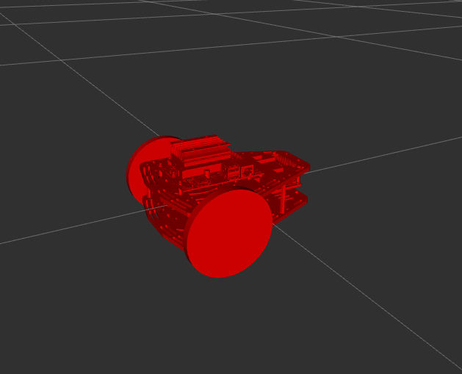
URDF Model – Activity
ACTIVITY DESCRIPTION:
You will be given an Incomplete PuzzleBot Jetson
Nano edition. Just the body with no wheels
You will add the wheels, joints, meshes and test
the joints are movable.
(aproximate time 35 min)
Go to activity sheet for more details.

Slide 29
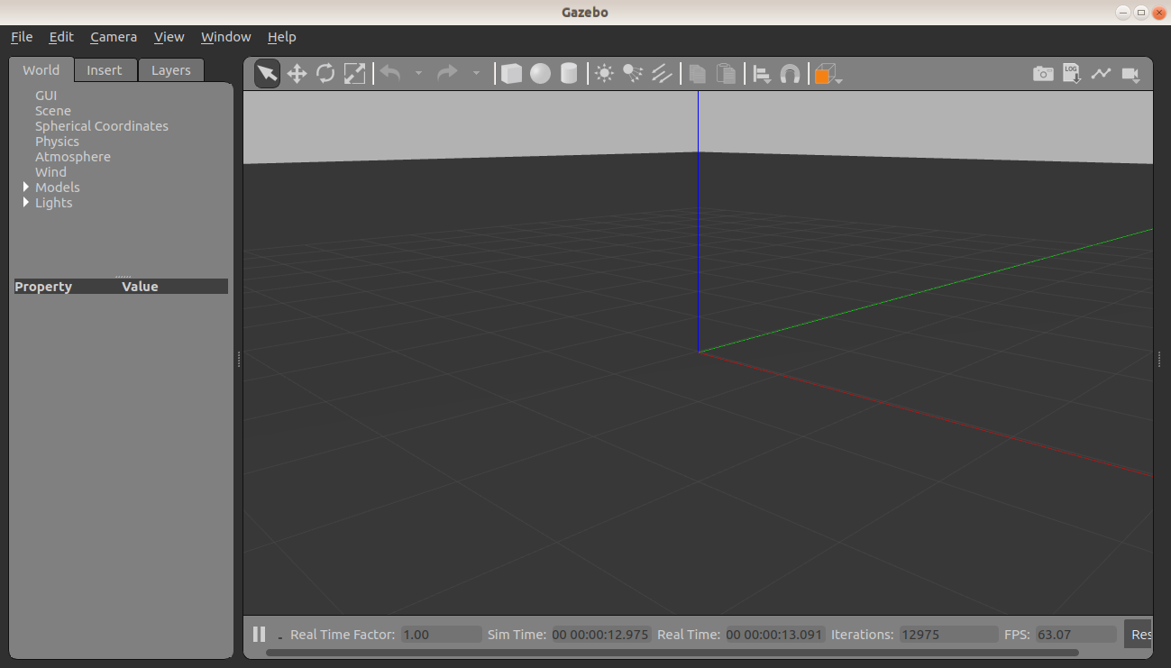
Gazebo Interface Introduction
Create shapes
Manipulation tools
Lights
Elements
in the world
More details in
Cheat sheet
SCENE

Slide 30
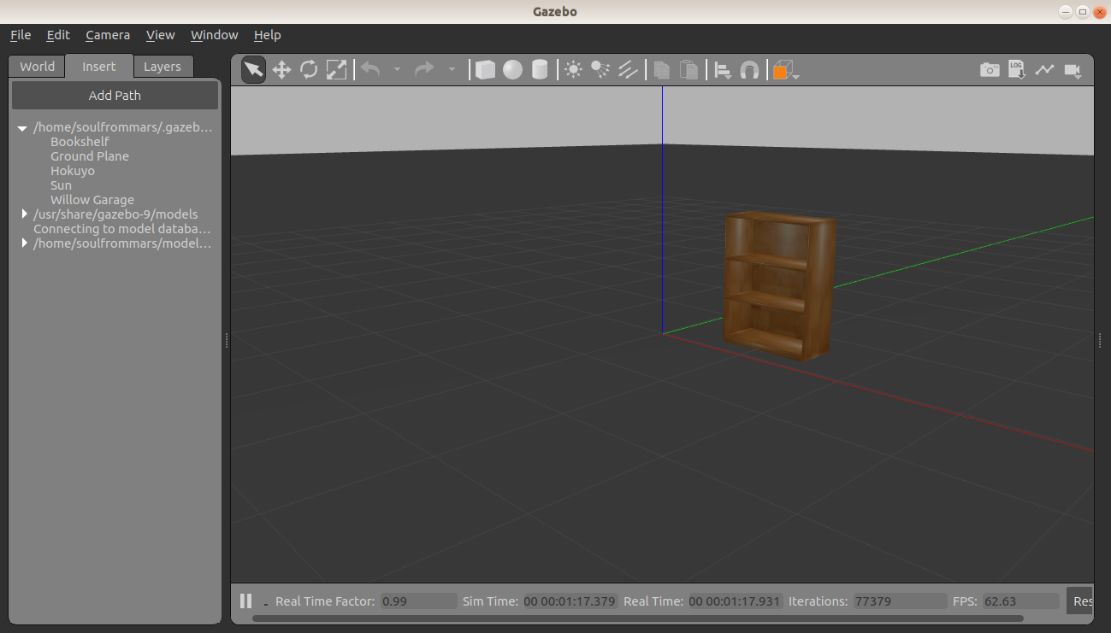
Gazebo How to spawn a library model
In the second tab,
Objects from the gazebo
Library are found.
Some other files can be added to a local library. Usually in home/.gazebo folder, but if required a model saved in the package can be loaded with a launch file.

Slide 31
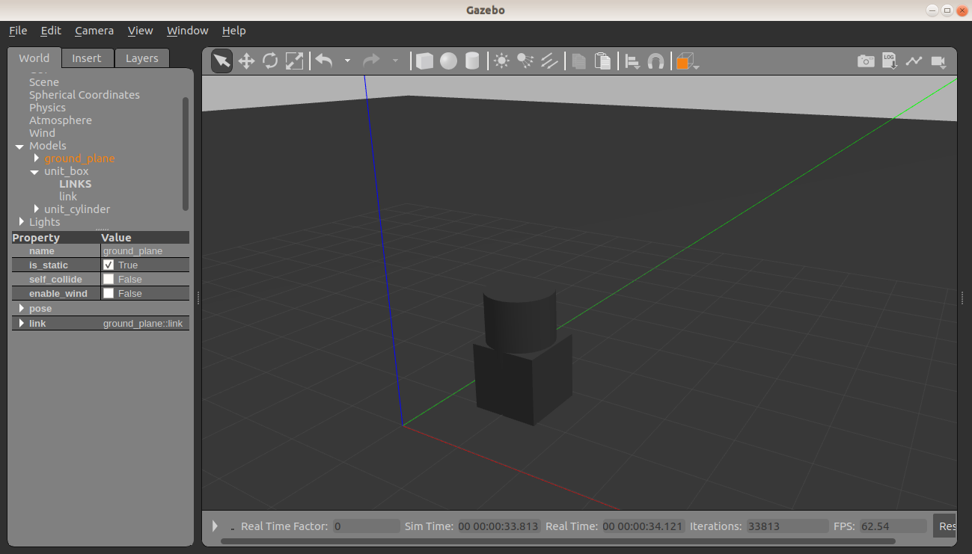
Gazebo How to create an object
It is possible to create
models, links, or simple
objects via the tools and
Also the model editor.
The important part is to
remember this is all saved in
SDF ( a gazebo format).
Also, the model editor cannot
Edit models or objects done
Using URDF or Xacro.
Notes:
<number>

Slide 32
Gazebo URDF Model vs SDF Model
URDF Model
ROS compatible (RVIZ)
Gazebo compatible with tags
Xacro compatible
Describes only robots
SDF Model
(Simulation Description format)
Gazebo compatible only
Can describe robots, 3D objects and 3D worlds
Can add plugins (describe sensor behaviours)
Conclusion: You probably need both

Slide 33
Gazebo How to use URDF with Gazebo tags
Tags rules
Required
An <inertia> element within each <link> element must be properly specified and configured.
Optional
Add a <gazebo> element for every <link>
Convert visual colors to Gazebo format
Convert stl files to dae files for better textures
Add sensor plugins
Add a <gazebo> element for every <joint>
Set proper damping dynamics
Add actuator control plugins
Add a <gazebo> element for the <robot> element
Add a <link name="world"/> link if the robot should be rigidly attached to the world/base_link
For a list of parameters that can be modified un gazebo, see Cheat sheet
Notes:
This tags are still xml tags.
<number>

Slide 34
Gazebo How to use URDF with Gazebo tags - example
Visuals- Material ( in URDF)
<material name="orange">
<color rgba="${255/255} ${108/255} ${10/255} 1.0"/>
</material>
Visuals- Material ( for gazebo compatibility)
<gazebo reference="link1">
<material>Gazebo/Orange</material>
</gazebo>
Notes:
This tags are still xml tags. This are diferences to
<number>

Slide 35
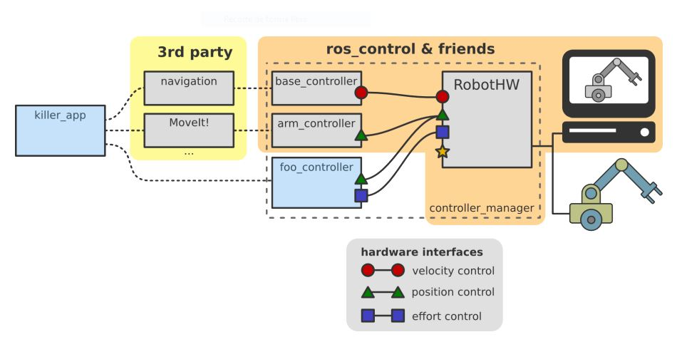
ROS Control Overview
Notes:
<number>

Slide 36
Gazebo Ros Control files
Files required
puzzlebot_control
│ ├── CMakeLists.txt
│ ├── config
│ │ ├── pid.yaml
│ │ ├── puzzlebot_control.yaml
│ │ └── puzzlebot_diff_control.yaml
│ ├── include
│ │ └── puzzlebot_control
│ │ └── Shared.hpp
│ ├── launch
│ │ └── puzzlebot_control.launch
│ ├── package.xml
│ └── src
│ └── puzzlebot_control_node.cpp
This files are here for reference, but remember
This example is an incomple version.
Please refer to the main puzzlebot model,
For a fully functional robot.
Notes:
This tags are still xml tags.
<number>

Slide 37
Gazebo Add transmissions
Tags rule
The main body requires the <transmission> tags in format XML.
In the body of the transmission we require:
<joint name=""> - the name must correspond to a joint else where in your URDF
<type> - the type of transmission. Currently only "transmission_interface/SimpleTransmission" is implemented. (feel free to add
more)
<hardwareInterface> - within the <actuator> and <joint> tags, this tells the gazebo_ros_control
plugin what hardware interface to load (position, velocity or effort interfaces).
Currently only effort interfaces are implemented. (feel free to add more)
For a list of parameters that can be modified un gazebo, see Cheat sheet
Notes:
This tags are still xml tags.
<number>

Slide 38
Gazebo Add gazebo_plugin
Tags rule
You need to add the following lines of code :
<gazebo>
<plugin name="gazebo_ros_control" filename="libgazebo_ros_control.so">
<robotNamespace>/MYROBOT</robotNamespace>
</plugin>
</gazebo>
For a list of parameters that can be modified un gazebo, see Cheat sheet
Notes:
This tags are still xml tags.
<number>

Slide 39
Gazebo Add gazebo_plugin
puzzlebot:
# Publish all joint states -----------------------------------
joint_state_controller:
type: joint_state_controller/JointStateController
publish_rate: 50
# Position Controllers ---------------------------------------
joint1_position_controller:
type: effort_controllers/JointPositionController
joint: joint1
pid: {p: 100.0, i: 0.01, d: 10.0}
joint2_position_controller:
type: effort_controllers/JointPositionController
joint: joint2
pid: {p: 100.0, i: 0.01, d: 10.0}
Yaml. files
For a list of parameters that can be modified un gazebo, see Cheat sheet
Notes:
This tags are still xml tags.
<number>

Slide 40
Gazebo Spawn URDF model in Gazebo
Open Gazebo
gazebo /path/empty.world
Open gazebo and specific world
gazebo /path/empty.world
Open in terminal using ROS
roslaunch MYROBOT_gazebo MYROBOT.launch

Slide 41
Gazebo – Activity
puzzlebot_gazebo
├── CMakeLists.txt
├── launch
│ ├── config1.rviz
│ ├── puzzlebot_gazebo.launch
│ └── puzzlebot_joints_test.launch
├── meshes
│ ├── camera.stl
│ ├── chassis.stl
│ └── wheel.stl
├── package.xml
└── urdf
├── macros.xacro
├── materials.xacro
├── parameters.xacro
├── puzzlebot.gazebo
└── puzzlebot.xacro
ACTIVITY DESCRIPTION:
Using the same model used in the first activity, add transmissions to the joint to use gazebo.
Add the gazebo_tags necessary to use the model in simulation
Run the world given, and spawn a letterbox, and build a wall. Save your new world.
(aproximate time 35 min)
Go to activity sheet for more details.

Slide 42
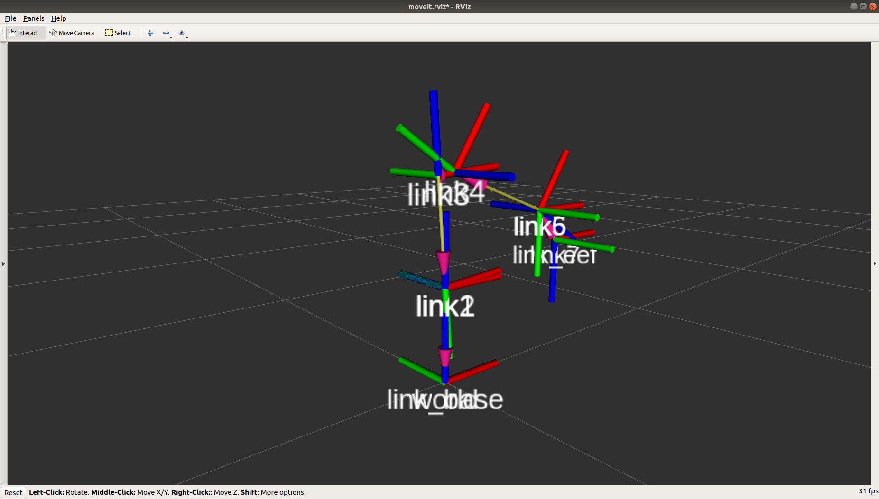
tf2 Introduction
”tf2 maintains the relationship between coordinate frames in a tree structure buffered in time, and lets the user transform points, vectors, etc between any two coordinate frames at any desired point in time.”
Notes:
Talk through the purpose of tf2
<number>

Slide 43
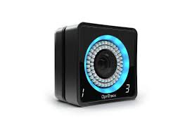
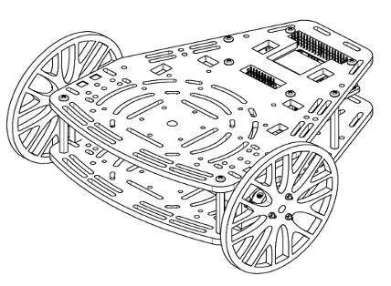

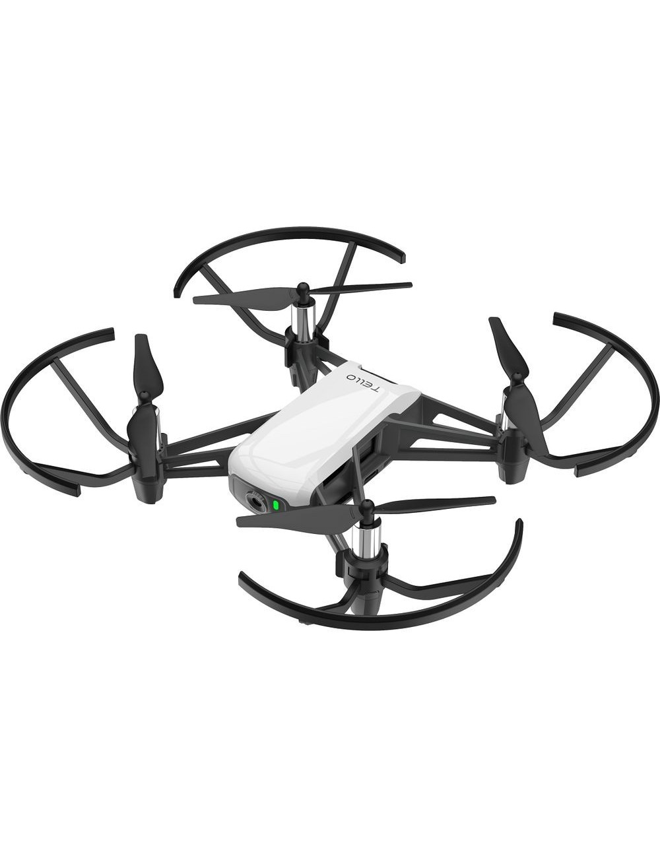
tf2 Concept
Common reference frame
Vision
Other robots
Manipulator
Notes:
Relate to a real scenario
<number>

Slide 44
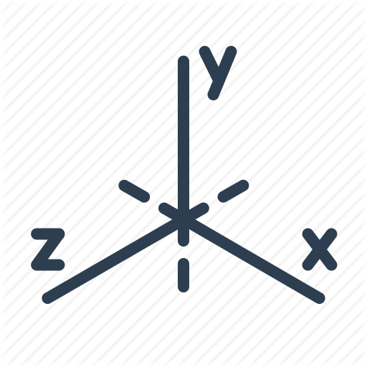
tf2 Static vs dynamic transform
Static Transform
Meant to be used to define transformations that are not going to be changing during the operational time.
Dynamic Transform
Used in scenarios where the relative position of the frame changes over time and needs to be updated
tf_static topic
tf topic
tf₀
tf₀
tf₁
tf₂
Notes:
Explain different types of transform
<number>

Slide 45
tf2 Computing a transform
# Initialize objects to store the transforms on them
self.tfBuffer = tf2_ros.Buffer() self.listener = tf2_ros.TransformListener(self.tfBuffer)
# Compute the transform between two frames at a given time
self.tfBuffer.lookup_transform("link_eef",data.frame,rospy.Time(),
rospy.Duration(0.5))
The Buffer object is used as a container for Listener to allocate the information retrieved from the function lookup_transform. In order to compute a transform, we need to provide the function with two frame names, destination and source, a time at which the transform is recorded and a time out. You can retrieve the transform between any two frames that can be connected though a tree.

Slide 46
tf2 Sending a transform
# Populate the vector with the transformation of the system
t = TransformStamped() t.header.stamp = rospy.Time.now() t.header.frame_id = "sensor_frame" t.child_frame_id = "goal" t.transform.translation = ”some_translation" t.transform.rotation = ”some_rotation"
# Input the transformation into the system
br = tf2_ros.StaticTransformBroadcaster() br.sendTransform(t)
# Input the transformation into the system
br = tf2_ros.TransformBroadcaster() br.sendTransform(t)
In order to send any transform within ROS the format of the transform must be TransformStamped(), which contains both a temporal reference and the transform object. Once the transform is defined it can be sent either as a static or dynamic transform by calling the appropriate sendTransform function from the broadcaster class.
Notes:
<number>

Slide 47
tf2 Debugging tools
The main tools used to analyze tf2 behavior are
Command line tools
rosrun tf2_tools view_frames.py
rosrun tf2 tf2_monitor turtle2 turtle1
rosrun tf tf_echo [base] [target]
RQT_tree: A graphical representation of all the relationships within the network
RVIZ: The temporal evolution of each transformation can be displayed in real time.
Broadcasting transforms in your launch files

Slide 48
tf2 Timing Concerns
Tf2 keeps track of the status of the system through time. It is very important to populate the header files to keep temporal relationships correct.
try: past = rospy.Time.now() - rospy.Duration(5.0) trans = tfBuffer.lookup_transform_full( target_frame = ‘robot1', target_time = rospy.Time.now(), source_frame = 'carrot1', source_time = past, fixed_frame = 'world', timeout = rospy.Duration(1.0) )
tf2 allows to compute the spatial distance in terms of translation and rotation between two frames in difference instances of time. In this example the position of ‘robot1’ in time t is expressed with respect 'carrot1’ in time t-5, considering 'world’ as a fixed frame maintaining its position between both time instances.

Slide 49
tf2 Practical example
Common reference frame
Base
Other robots
Obstacle
Notes:
Relate to a real scenario
<number>

Slide 50
Previous steps Installation of MoveIt! and Xarm dependencies
Xarm installation tutorial
rosdep update
rosdep check --from-paths . --ignore-src --rosdistro melodic
rosdep install --from-paths . --ignore-src --rosdistro kinetic –y
sudo apt install ros-melodic-ros-control ros-kinetic-ros-controllers
MoveIt installation tutorial
sudo apt install ros-melodic-moveit
Notes:
<number>

Slide 51
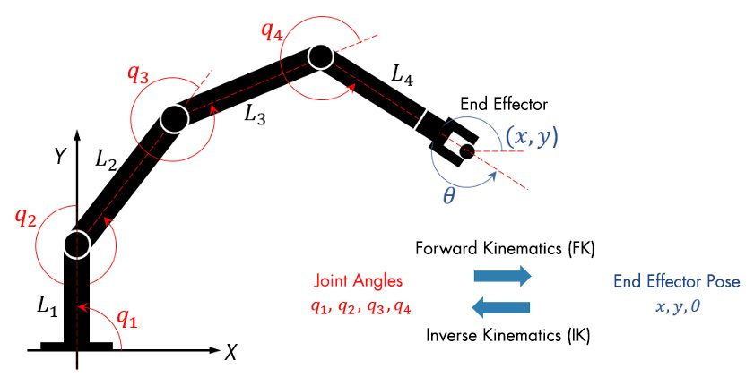
Xarm Model of a robotic arm
Notes:
Source: https://www.mathworks.com/discovery/inverse-kinematics.html
<number>

Slide 52
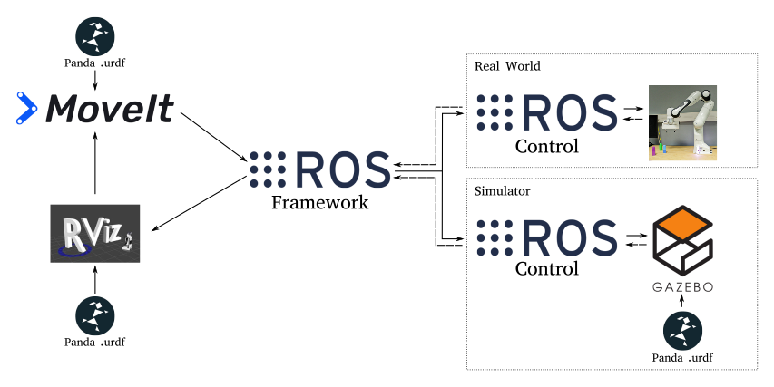
MoveIt! Introduction
Notes:
https://sebastianwallkoetter.wordpress.com/2020/03/08/franka-emika-panda-in-gazebo-with-ros-and-docker/
https://www.theconstructsim.com/ros-movelt/
It is better to go through the wizard with screen sharing, this slides are only a resource so that they have a written description of all the available options.
<number>

Slide 53
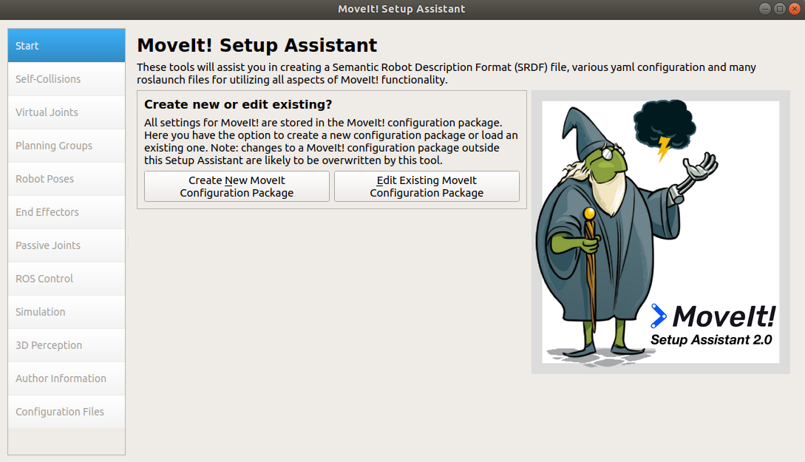
MoveIt! Set Up
This wizard generates the planner code so that any manipulator can be commanded easily in ROS, either in simulation or in real life.
Notes:
https://sebastianwallkoetter.wordpress.com/2020/03/08/franka-emika-panda-in-gazebo-with-ros-and-docker/
https://www.theconstructsim.com/ros-movelt/
<number>

Slide 54
MoveIt ! Wizard Summary
Load urdf models into the planner
Create or modify config packages created for a given robot
Add self collisions between links
Manage how links interact with each other
Add virtual joints to link the world with the robot framework
Use auxiliar joints to relate the robot with the rest of the world
Add planning groups
Divides the joints in groups for the planner to use when generating a path
Add passive joints
Defines non-actuable joints
Add controllers
Attaches ROS controllers to each of the joints
Manage simulated environment
Input 3D information of the environment
You can add depth sensors to detect obstacles that need to be avoided by the arm

Slide 55
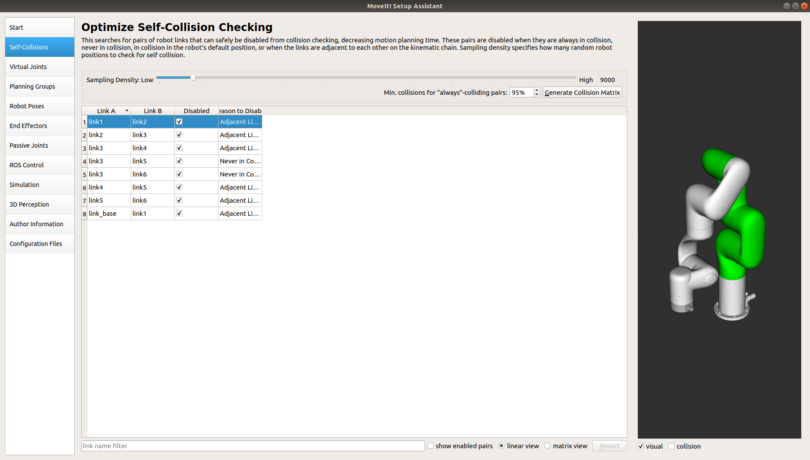
MoveIt ! Wizard Self-Collision
This set of options is used to prevent unnecessary collision simulation between links and avoid unrealistic collisions. For example, if two links are in contact, we don’t want our planner to treat it as a collision and thus it is included in this list.

Slide 56
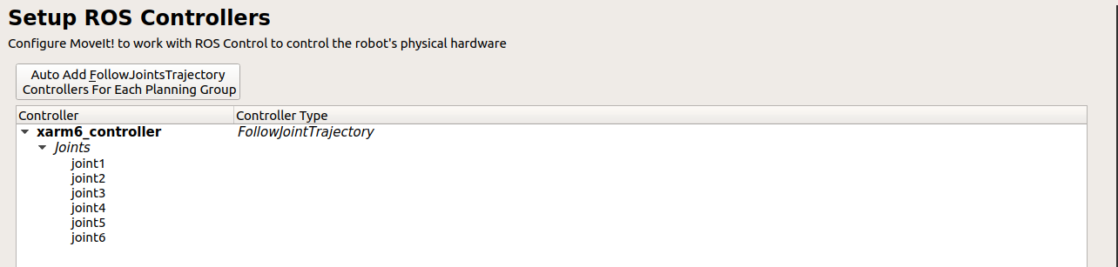
MoveIt ! Wizard Controllers
Screen devoted to add controllers to the joints of your robot. You already know how to do it working directly with urdf files, but it may be convenient to do it directly from this menu.

Slide 57
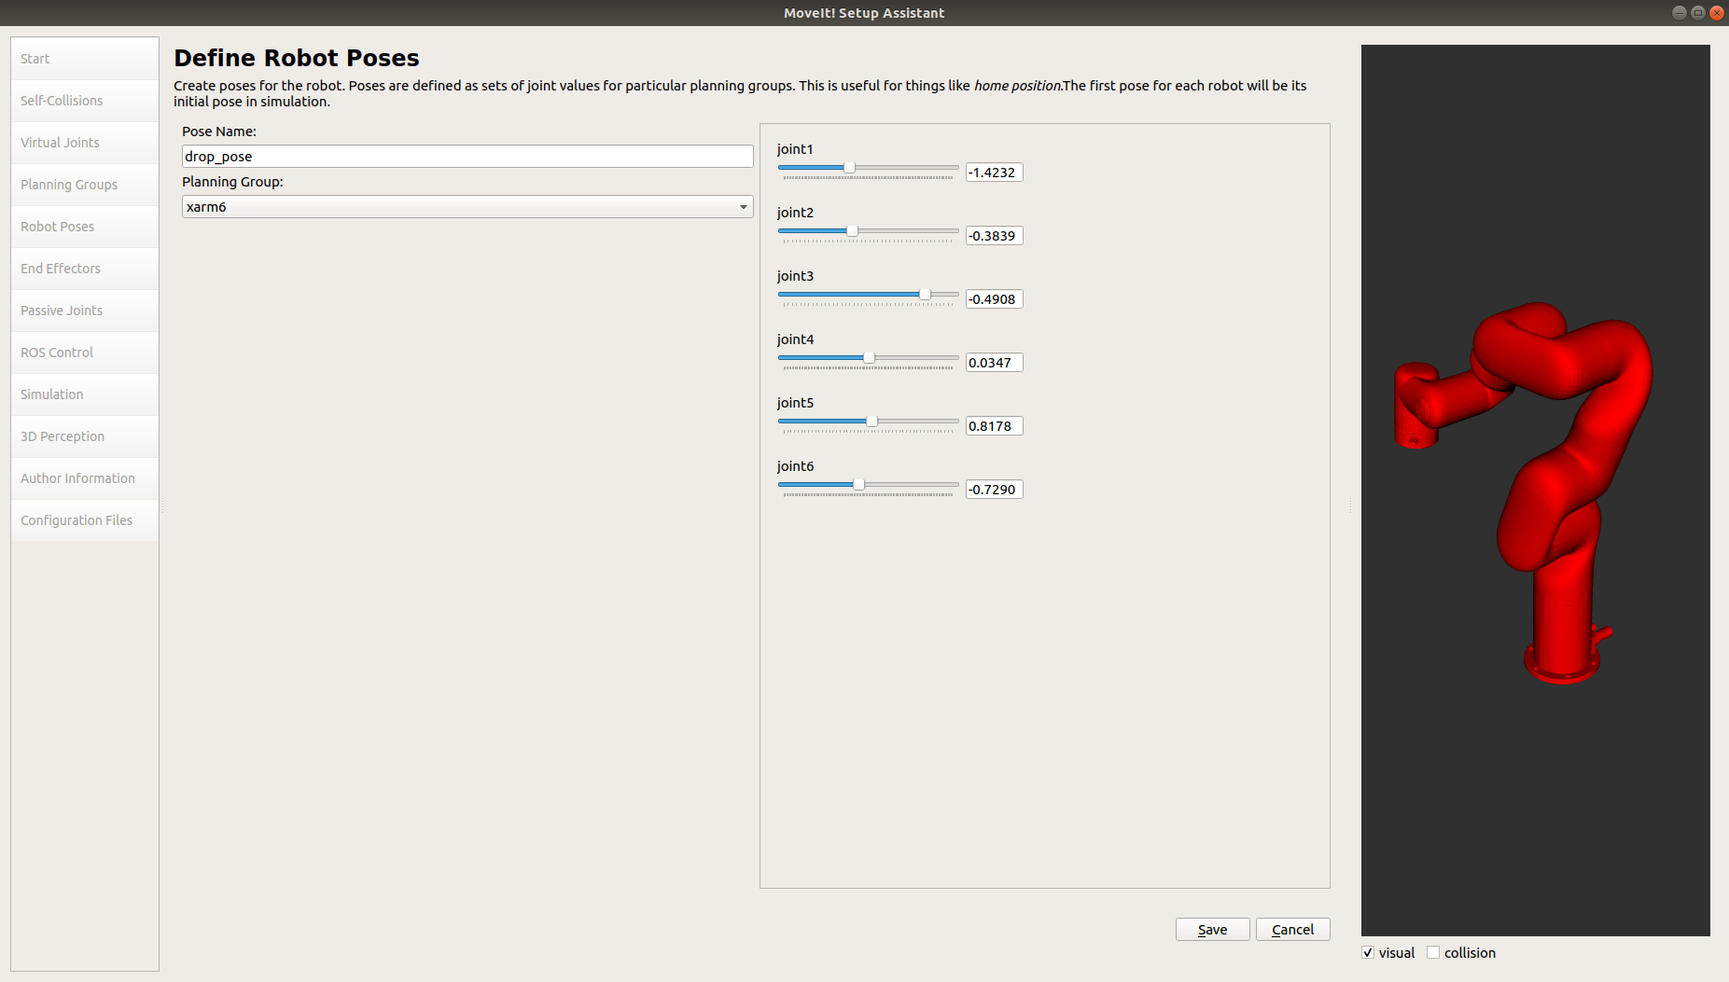
MoveIt ! Wizard Robot Poses
This screen is used to preprogram poses in the planner. If you plan to travel to the same position repeatedly it is easier to encode it once and then access to it without using by its keyword.

Slide 58
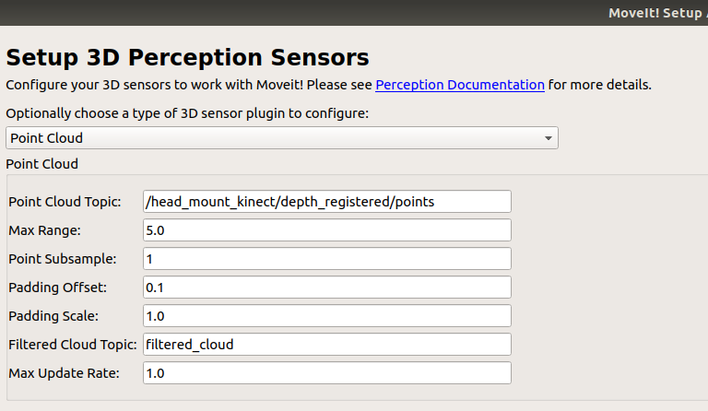
MoveIt! Wizard Perception
You can include perception to you planner by linking either a point cloud or a 3D camera. In that case obstacles detected will be represented as voxels in the planning space. Any plan derived will avoid those obstacles.
Notes:
https://sebastianwallkoetter.wordpress.com/2020/03/08/franka-emika-panda-in-gazebo-with-ros-and-docker/
https://www.theconstructsim.com/ros-movelt/
<number>

Slide 59
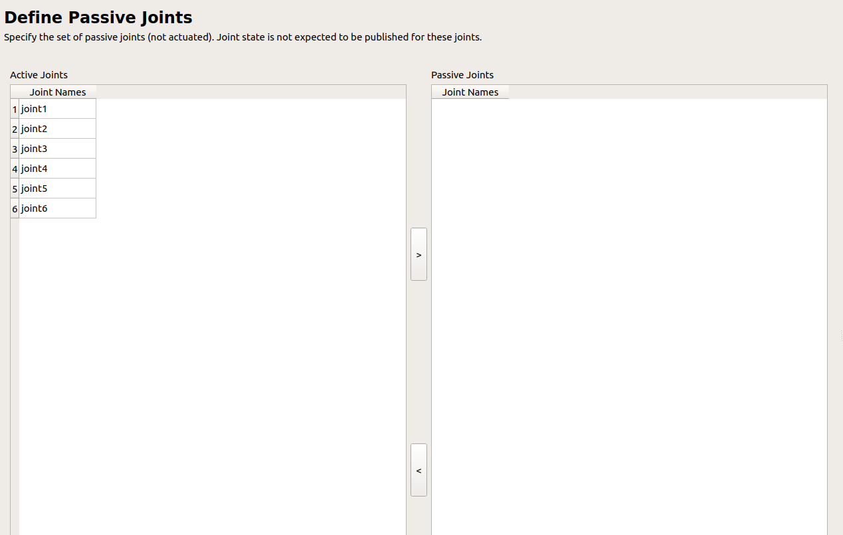
MoveIt! Wizard Passive Joints
Passive joints are used to define non-actuated joints, which are not associated to any actuator. In that case the planner will consider the presence of that joint to derive paths and simulate its behavior, but won't provide control actions for them.

Slide 60
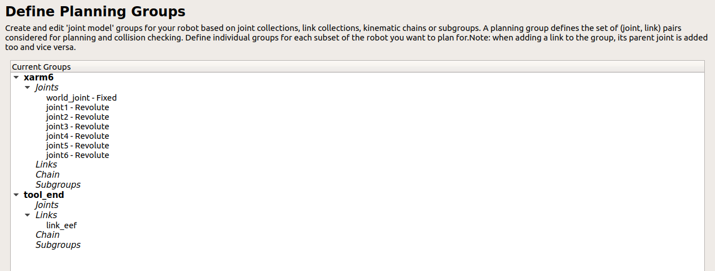
MoveIt! Wizard Plan Groups
MoveIt! Allow subdivisions of joints into groups so that you can plan movements affecting only a subset of the robot, diminishing the computational time. It is common to, at least, define two subgroups so that arm and tool can be used independently.

Slide 61

Activity Modifying a robot world using MoveIt
Load the robot_model package that we provided to you
Using the appropriate window, add a box in the environment and save the current configuration
Move it Wizard
World

Slide 62


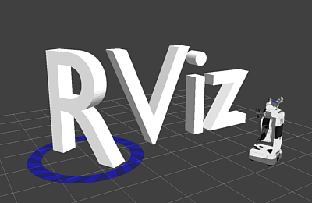

MoveIt! Rviz Interface
Most of the tools available in MoveIt can be applied to either real or simulated robot by sending commands through a visual interface coded in Rviz.
It is recommended to code your applications but is useful to test some of the movements beforehand.
Notes:
https://sebastianwallkoetter.wordpress.com/2020/03/08/franka-emika-panda-in-gazebo-with-ros-and-docker/
https://www.theconstructsim.com/ros-movelt/
It is better to go through the wizard with screen sharing, this slides are only a resource so that they have a written description of all the available options.
<number>

Slide 63
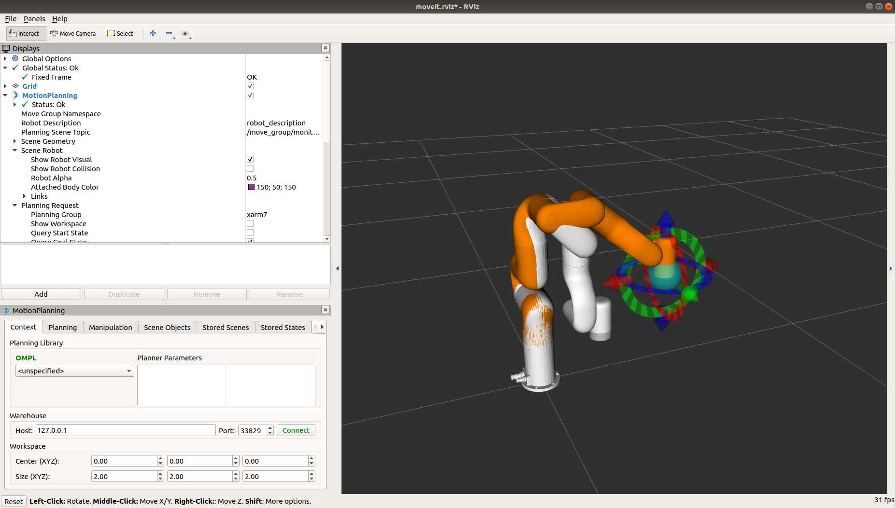
MoveIt! Rviz Interface
API to plan an execute movements though an user interface based on RVIZ.
Allows to configure different planning algorithms to drive the robot through the scene.
Tool to use the robot without having to code, only using visual tools.
Notes:
https://sebastianwallkoetter.wordpress.com/2020/03/08/franka-emika-panda-in-gazebo-with-ros-and-docker/
https://www.theconstructsim.com/ros-movelt/
<number>

Slide 64
MoveIt! Rviz Interface
Main window of the API, allows setting up the connection to a real robot, configure the planner by choosing from a list of available algorithms and set up the center of a workspace.
Notes:
https://sebastianwallkoetter.wordpress.com/2020/03/08/franka-emika-panda-in-gazebo-with-ros-and-docker/
https://www.theconstructsim.com/ros-movelt/
<number>

Slide 65
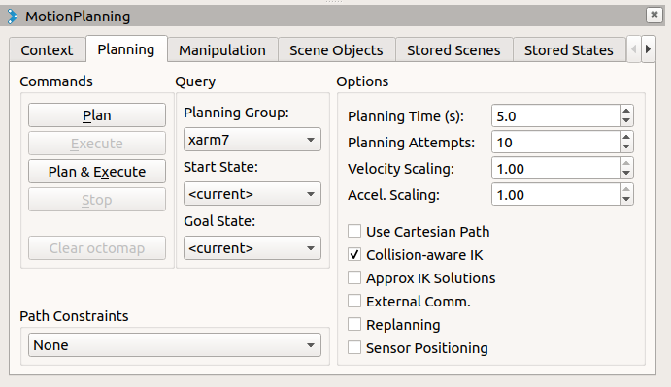
MoveIt! Rviz Interface
The ”Plan” window is used to limit some aspects from the planner, to adapt its performance to the needs of the user. Once the planner is set up you can either plan or execute a path for any of the groups defined in the set up step.

Slide 66
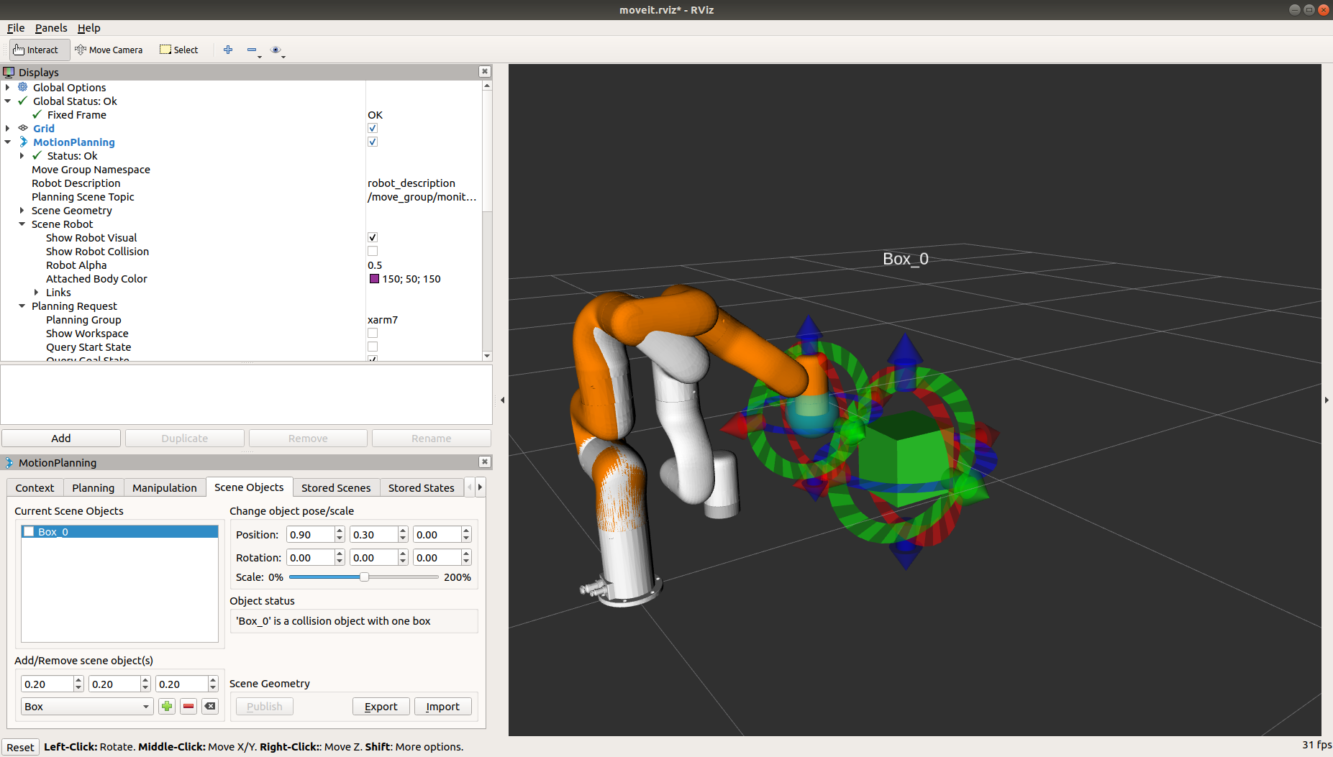
MoveIt! Rviz Interface
This window allows to place obstacles within the navigation space. Similarly, to what we’ve already seen in the setup phase, this option creates areas in the space that are avoided by the planner.

Slide 67
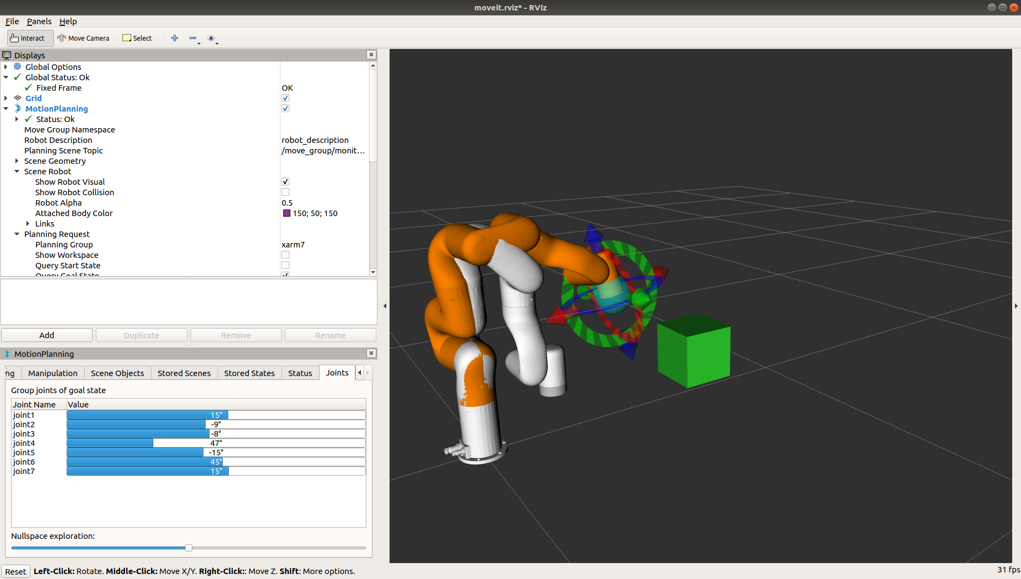
MoveIt! Rviz Interface
Menu used to set the value of any joint within the current operational group to a given value. It also allows to set up the value at which the null space is explored, which refers to the number of redundant positions that are explored.

Slide 68
Activity Controlling the robot through the interface
Run the Rviz interface using the package generated in the previous activity
Using the appropriate commands, pick the obstacle that you added and place it in another part of the environment.
Rviz Interface

Slide 69
MoveIt! Python API
Move It! Is a set of tools used to easily integrate path planning with robotic manipulators. Originally, the library is written in Cpp but there’s a Python integration that maps the functions that are commonly used by standard users.
You can access most of the configuration tools available by MoveIt, however the specific parameters, sometimes dangerous for an untrained user, can only be changed used the original Cpp API.
Notes:
https://sebastianwallkoetter.wordpress.com/2020/03/08/franka-emika-panda-in-gazebo-with-ros-and-docker/
https://www.theconstructsim.com/ros-movelt/
<number>

Slide 70
MoveIt! Python API
class Planner(): def __init__(self): moveit_commander.roscpp_initialize(sys.argv) self.robot = moveit_commander.RobotCommander() self.scene = moveit_commander.PlanningSceneInterface() self.group = moveit_commander.MoveGroupCommander("xarm7") self.link_ee = self.group.get_end_effector_link()
When coding with Move It! we need to consider three objects. Firstly, the RobotCommander, which controls the commands that are send to the arm. Secondly, the PlanningSceneInterface, which models the environment at which the plans will be derived. Finally, we need to take into account which group is going to be considered to derive a plan.
Notes:
https://sebastianwallkoetter.wordpress.com/2020/03/08/franka-emika-panda-in-gazebo-with-ros-and-docker/
https://www.theconstructsim.com/ros-movelt/
<number>

Slide 71
MoveIt! Move
def goToPose(self,pose): self.group.set_pose_target(target) self.group.go(wait=True) self.group.stop() self.group.clear_pose_targets()
def go_to_joint_state(self): joint_goal[0] = [0,0,0,pi/2,0,pi/4,0] self.group.go(joint_goal, wait=True) group.stop()
In order to send the robot to a desired pose we need to set it as a target and call go, blocking the code until the target is achieved. As a good practice is recommended to stop the robot and clean the current target afterwards.
Alternatively, you can drive the robot by setting a set of joint angles, and the planner will derive a suitable path and execute it.
Notes:
https://sebastianwallkoetter.wordpress.com/2020/03/08/franka-emika-panda-in-gazebo-with-ros-and-docker/
https://www.theconstructsim.com/ros-movelt/
<number>

Slide 72
MoveIt! Add Obstacles
def add_box(self, timeout=4): box_pose = geometry_msgs.msg.PoseStamped() box_pose.header.frame_id = "link_tcp”
# Populate the vector with the position of the obstacle box_pose.pose.orientation.w = 1.0
# Add the box to the scene self.scene.add_box("box", box_pose, size=(0.1, 0.1, 0.1))
def remove_box(self, box_name,timeout=4): self.scene.remove_world_object(box_name)
We can add obstacles to the environment by defining the position of and the shape of the object, either using a predefined shape (box, sphere or cylinder) or a custom 3D shape. In this case on of the predefined shapes is used to represent an obstacle that will be avoided by the planner.
Once the obstacle is not in the environment anymore we can remove it using the tag associated to it.
Notes:
https://sebastianwallkoetter.wordpress.com/2020/03/08/franka-emika-panda-in-gazebo-with-ros-and-docker/
https://www.theconstructsim.com/ros-movelt/
<number>

Slide 73
MoveIt! Attach and detach
def attachBox(self,box_name): grasping_group = 'vacuum_gripper' touch_links = self.robot.get_link_names(group=grasping_group) self.scene.attach_box(self.link_ee, box_name + "_planner", touch_links=touch_links)
Sometimes the robot will be carrying some cargo, for instance when executing a pick and place. In those cases, both cargo and robot becomes a unique element for the planner, as trajectories have to be non-colliding considering both objects. In order to
def detachBox(self,box_name): self.scene.remove_attached_object(self.link_ee, name=box_name)
Once the cargo is no longer attached to the end effector we need to tell the planner that it shouldn’t consider anymore.
Notes:
https://sebastianwallkoetter.wordpress.com/2020/03/08/franka-emika-panda-in-gazebo-with-ros-and-docker/
https://www.theconstructsim.com/ros-movelt/
<number>

Slide 74
MoveIt! Generate plans
def plan_cartesian_path(self, eef_step,jump_th ,waypoints):
(plan, fraction) = group.compute_cartesian_path(waypoints,eef_step,jump_th)
Cartesian path
Compute a sequence of waypoints that make the end-effector move in straight line segments that follow the poses specified as waypoints. The resulting path has a point every eef_step (m) with a maximum distance jump of jump_th (m). The return value is a tuple containing a fraction of how much of the path was followed and the actual plan.
Notes:
https://sebastianwallkoetter.wordpress.com/2020/03/08/franka-emika-panda-in-gazebo-with-ros-and-docker/
https://www.theconstructsim.com/ros-movelt/
<number>

Slide 75
MoveIt ! Useful functions
group.get_planning_frame()
group.get_end_effector_link()
group.clear_target()
group.get_active_joints()
group.execute()
group.get_current_joint_values()
group.get_current_pose()
group.get_current_rpy()
robot.get_group_names()
robot.get_current_state()
Notes:
https://sebastianwallkoetter.wordpress.com/2020/03/08/franka-emika-panda-in-gazebo-with-ros-and-docker/
https://www.theconstructsim.com/ros-movelt/
<number>

Slide 76
Activity Pick and Place
Load the gazebo world that we provided to you
Make a pick-and-place application, moving each object to the container with the matching color.
Python Code

